Slide 1
METCS777 – Final Project TMDB Movies Natali Ayoub

Slide 2
Project analysis slide 2
Data Attributes
Movie Title
Runtime
Movie Genre
TMDB 5000 Movie Dataset
Release Date
Budget
Average Rating
Revenue
Popularity

Slide 3
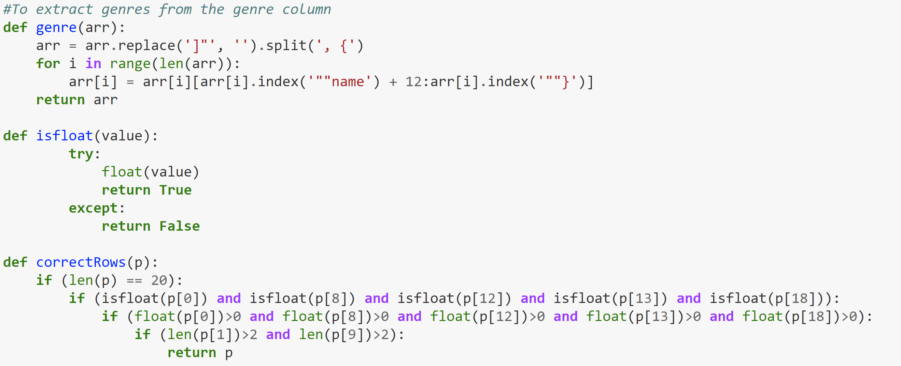
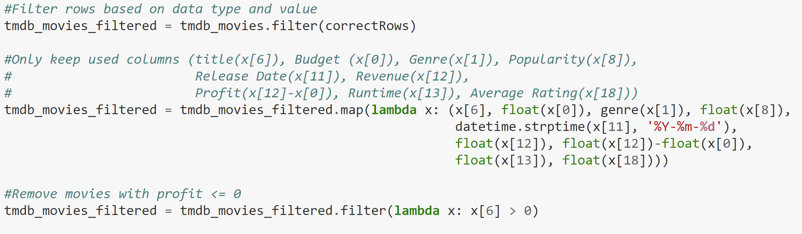
Project analysis slide 2
Data Cleaning
Number of rows before cleaning: 4806
Number of rows after cleaning: 2353

Slide 4
Exploratory Data Analytics

Slide 5
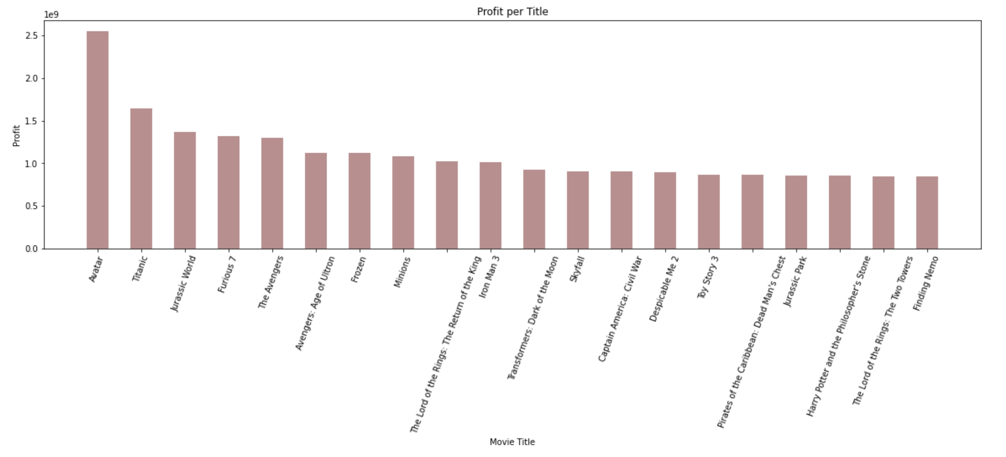
Project analysis slide 3
Top 10 Most Profitable Movie Titles

Slide 6
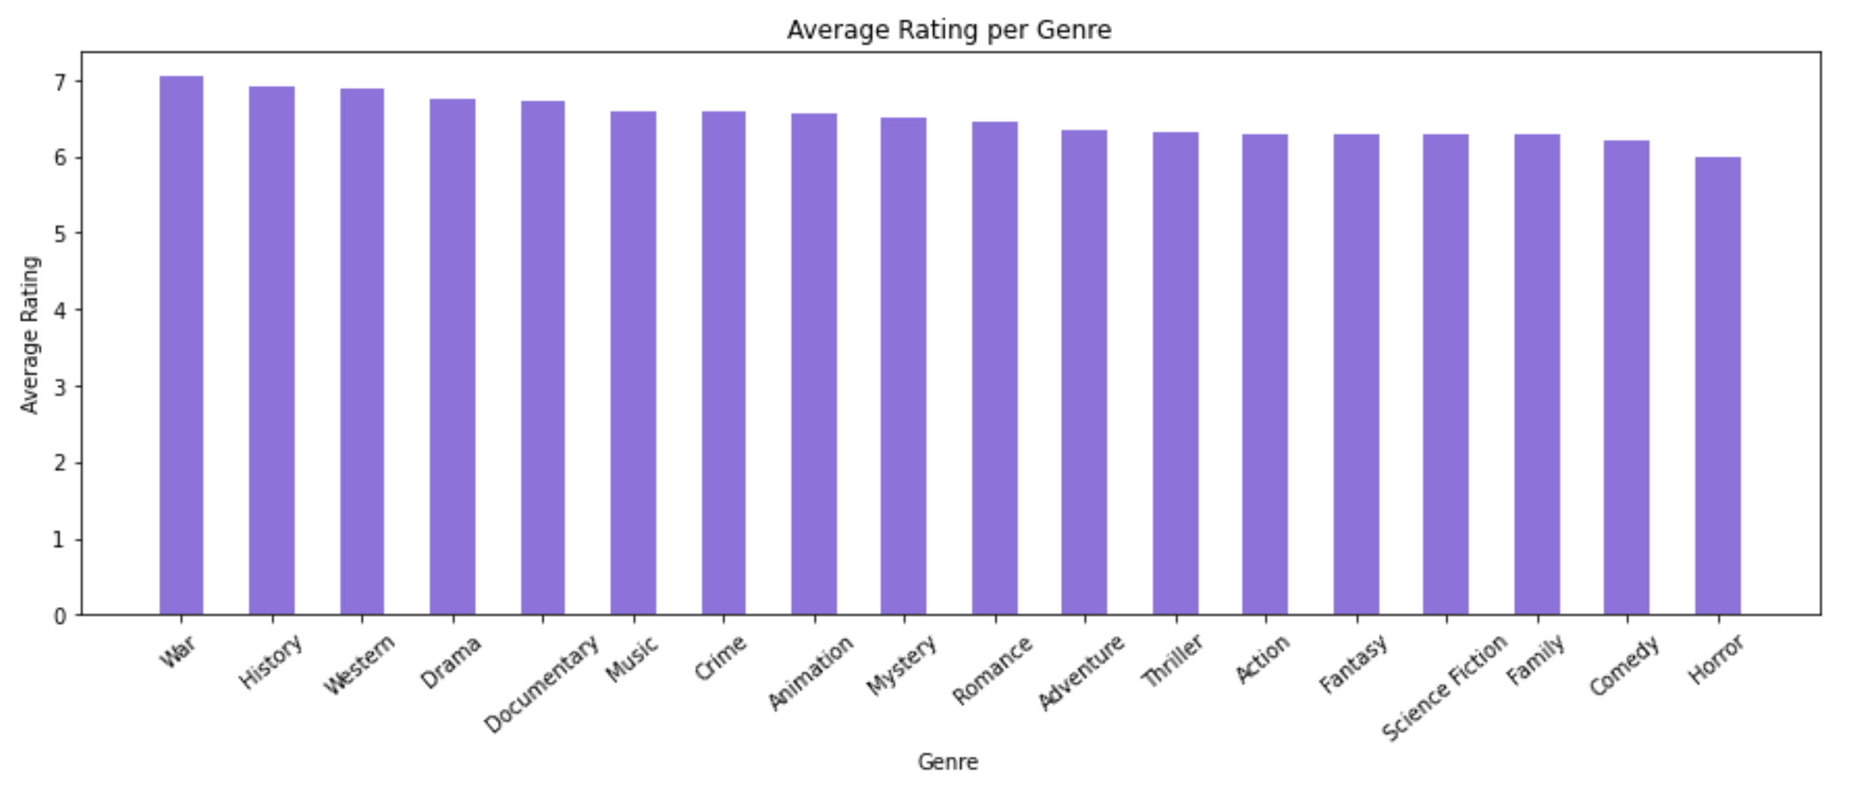
Project analysis slide 3
Average Rating per Genre

Slide 7
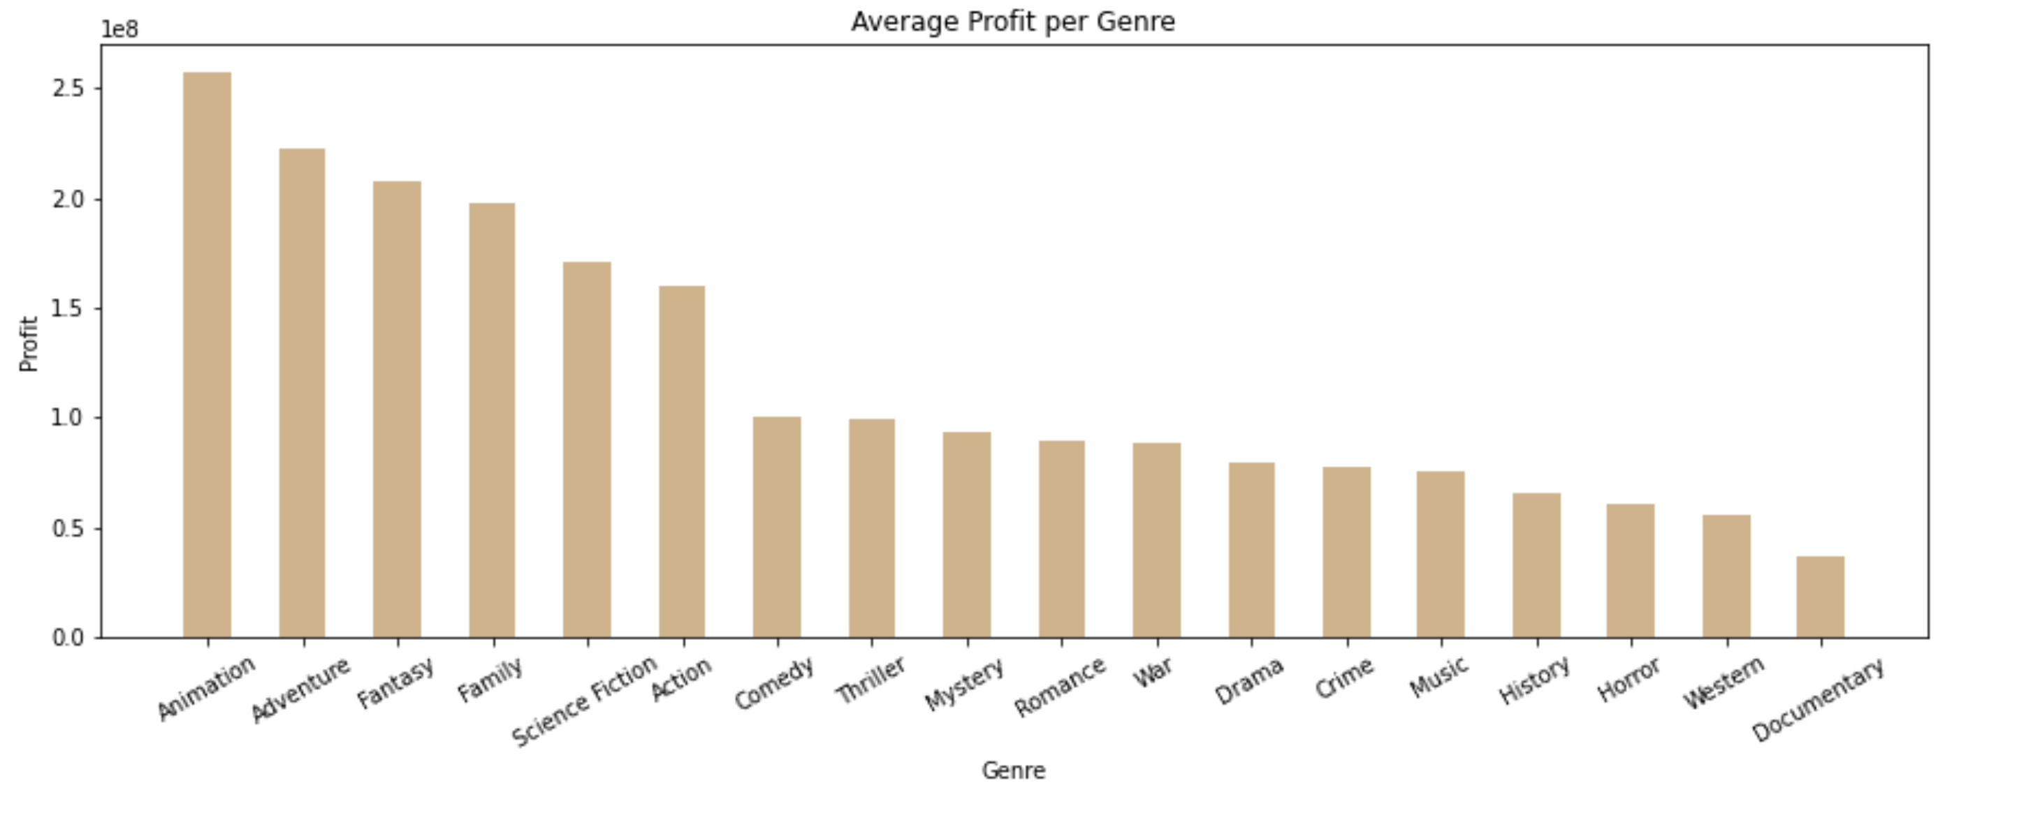
Project analysis slide 3
Average Profit per Genre

Slide 8
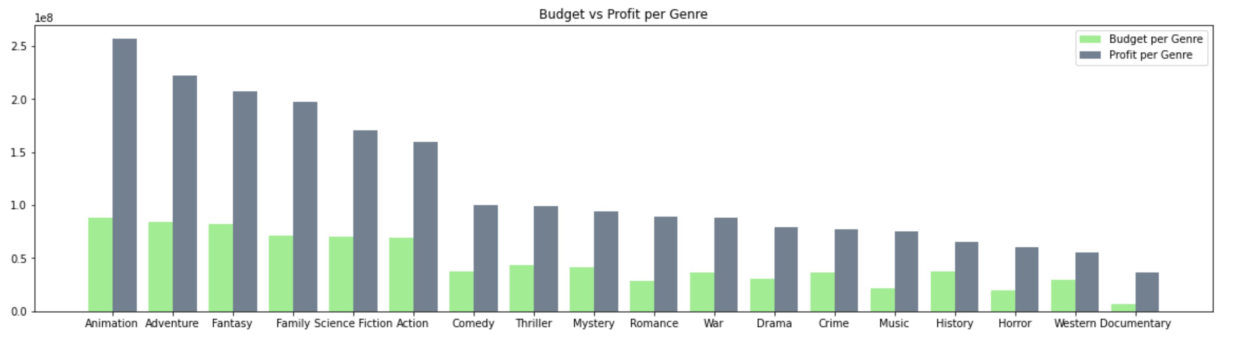
Project analysis slide 3
Budget vs Profit per Genre

Slide 9
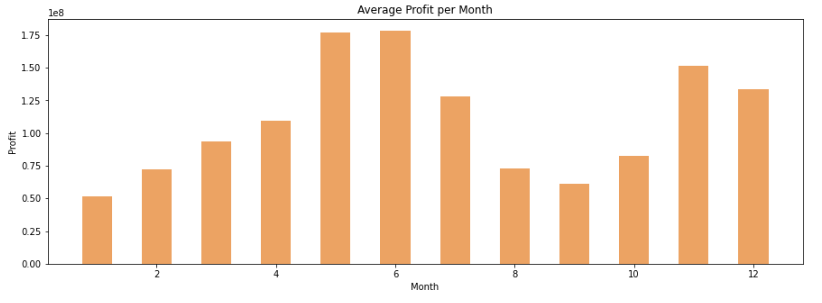
Project analysis slide 3
Average Profit per Month

Slide 10
Machine Learning
Linear Regression to Predict Profit
(Revenue – Budget)

Slide 11
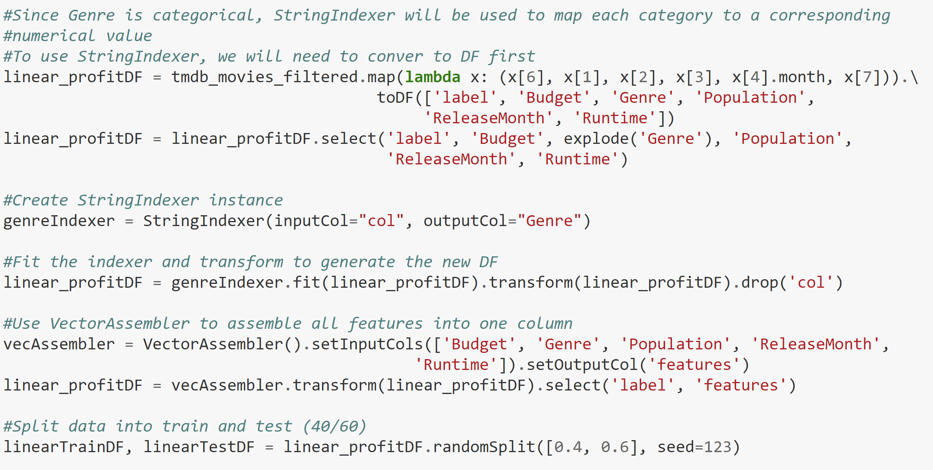
Project analysis slide 3
Preparing Attributes and Splitting Data

Slide 12
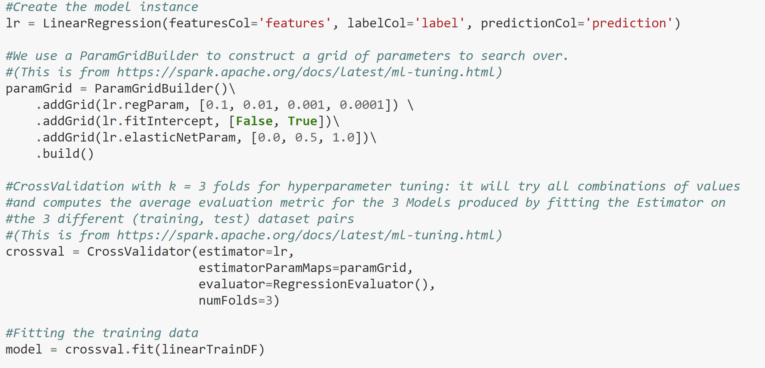
Project analysis slide 3
Creating and Training the Model

Slide 13
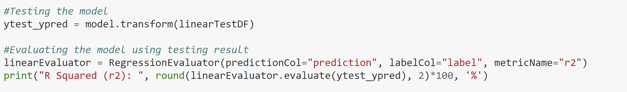
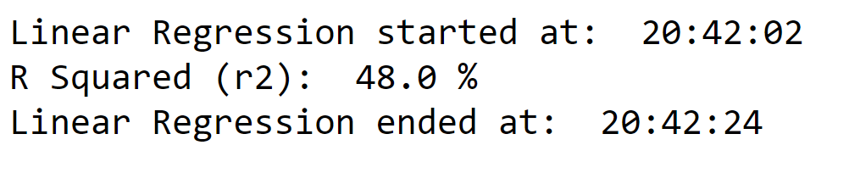
Project analysis slide 3
Testing and Evaluating the Model

Slide 14
Machine Learning
Logistic Regression to Evaluate Success
1 (Successful): If Average Rating is >= 6.0
0 (Unsuccessful): If Average Rating is < 6.0

Slide 15
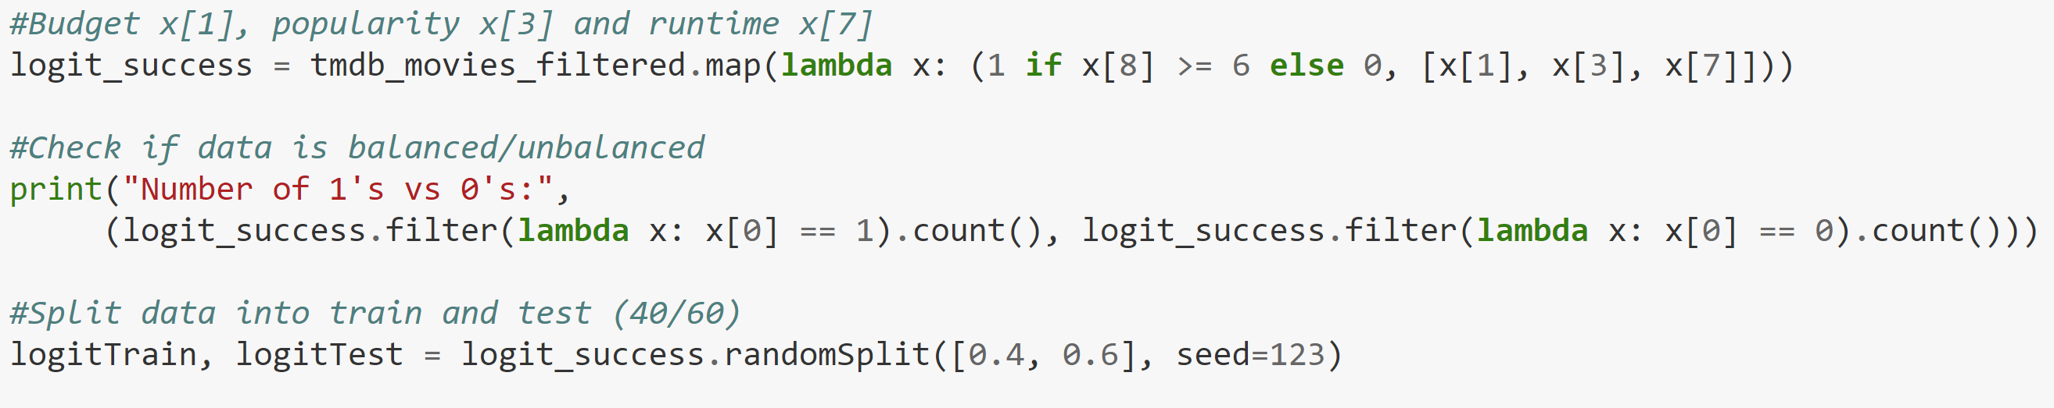
Project analysis slide 3
Preparing Attributes and Splitting Data

Slide 16
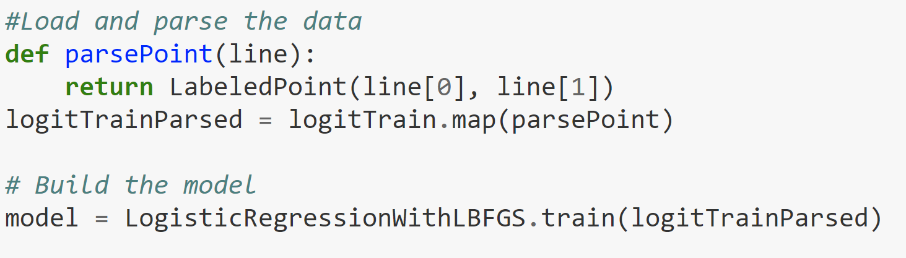
Project analysis slide 3
Creating and Training the Model

Slide 17
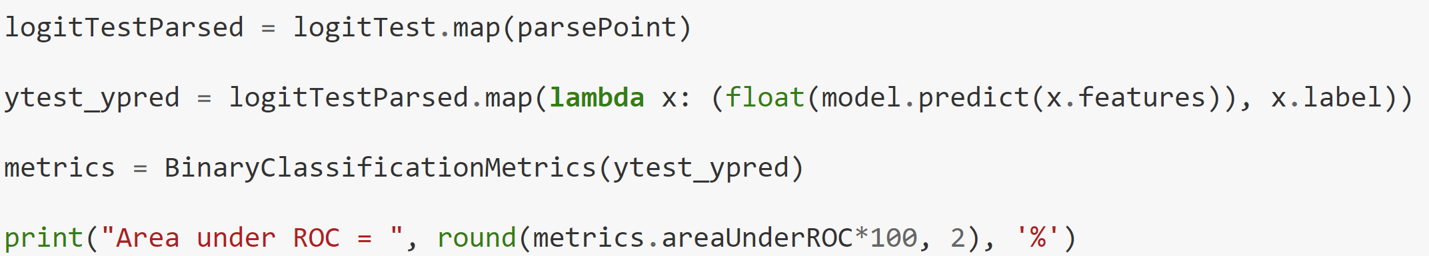
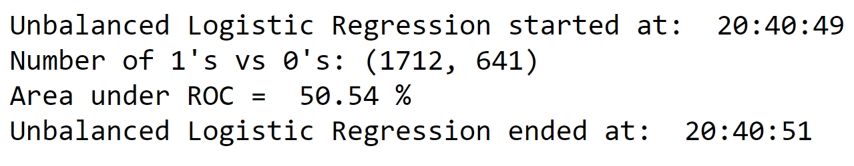
Project analysis slide 3
Testing and Evaluating the Model

Slide 18
Machine Learning
Logistic Regression to Evaluate Success
Using Weights and Hyperparameter Tuning
1 (Successful): If Average Rating is >= 6.0
0 (Unsuccessful): If Average Rating is < 6.0

Slide 19
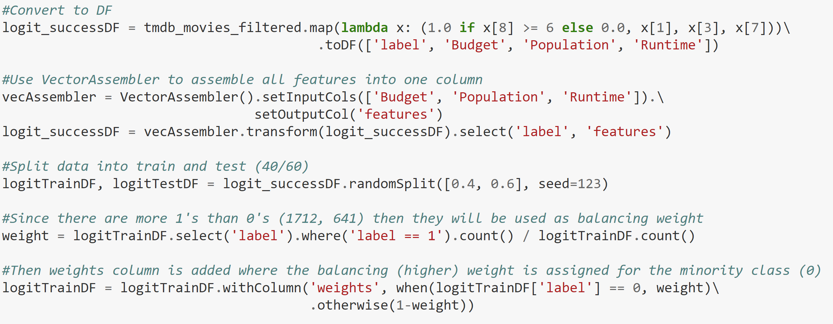
Project analysis slide 3
Preparing Attributes and Splitting Data

Slide 20
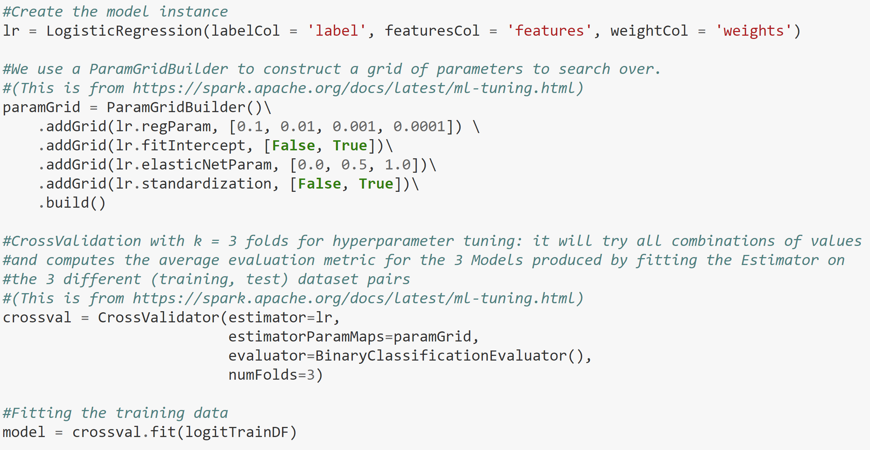
Project analysis slide 3
Creating and Training the Model

Slide 21
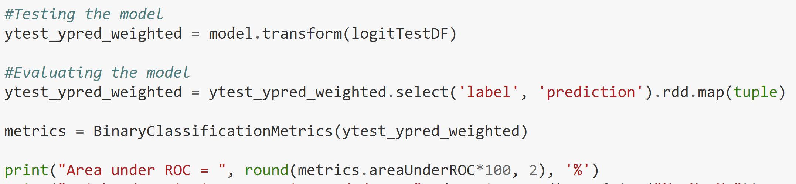
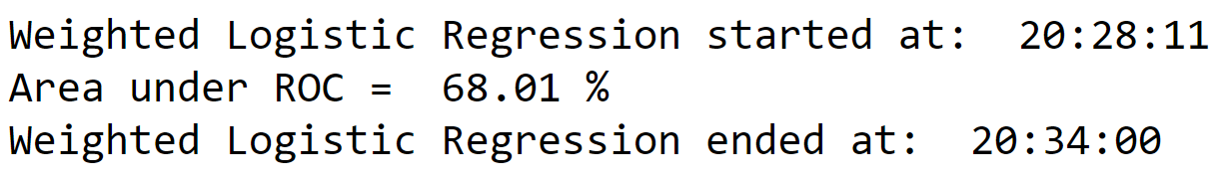
Project analysis slide 3
Testing and Evaluating the Model

Slide 22
Thank You!
If you have any questions or like to connect, you can reach me at:
nayoub@bu.edu
https://www.linkedin.com/in/natali-ayoub/

